Slide 1
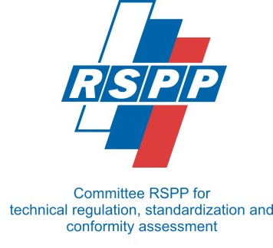
Work Group: Machinery & Equipment
Dr. Thomas Krause (ALPHA)
Benjamin Oppermann (SMS GROUP)
12.03. 2019 | Moscow

Slide 2

Objectives defined by the German working group |
1. Optimization of the most important Technical Regulations for machines and plants
2. Mutual understanding about the requirements of the technical regulation
3. Mutual recognition of test protocols in the case of compliance with certain quality criteria (to be determined)
4. Ensuring market access opportunities for German and Russian manufacturers and engineering companies by improving mutual recognition of testing services and thereby improving market access under certain quality conditions
Implementation in practice ?

Slide 3
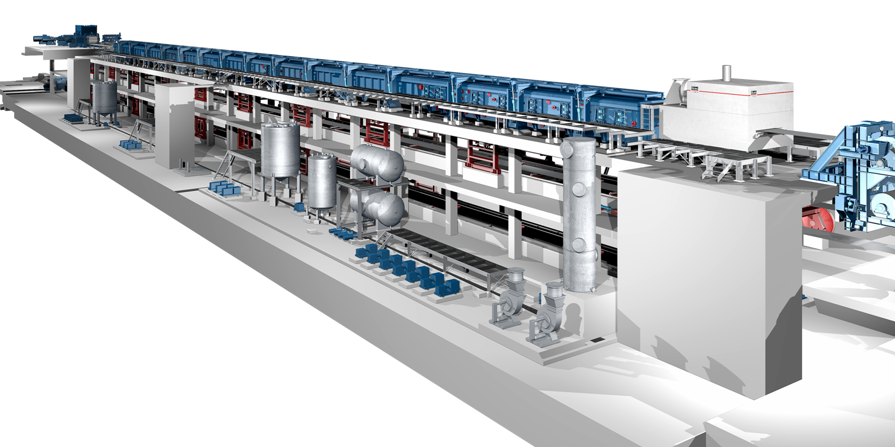

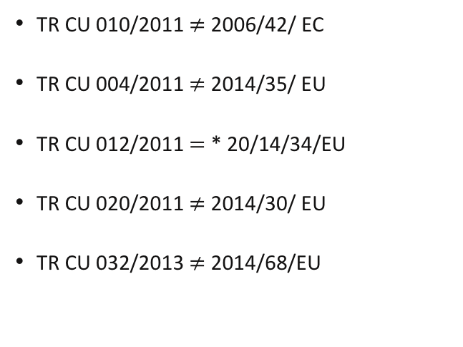
1. Optimization of the most important Technical Regulations for machines and plants
TR CU 010/2011 $≠$ 2006/42/ EC
TR CU 004/2011 $≠$2014/35/ EU
TR CU 012/2011 $=$* 20/14/34/EU
TR CU 020/2011 $≠$2014/30/ EU
TR CU 032/2013 $≠$2014/68/EU
Machinery & Equipment

Slide 4
2. Mutual understanding about the requirements of the technical regulation
Clarification of interpretation of the TR Regulation is not clear in some single Detail (Pressure Equipment Assembly)
Example: TR ZU 032/2013, Table 8
Aim: Transparency of Regulation System (Road Map)

Slide 5
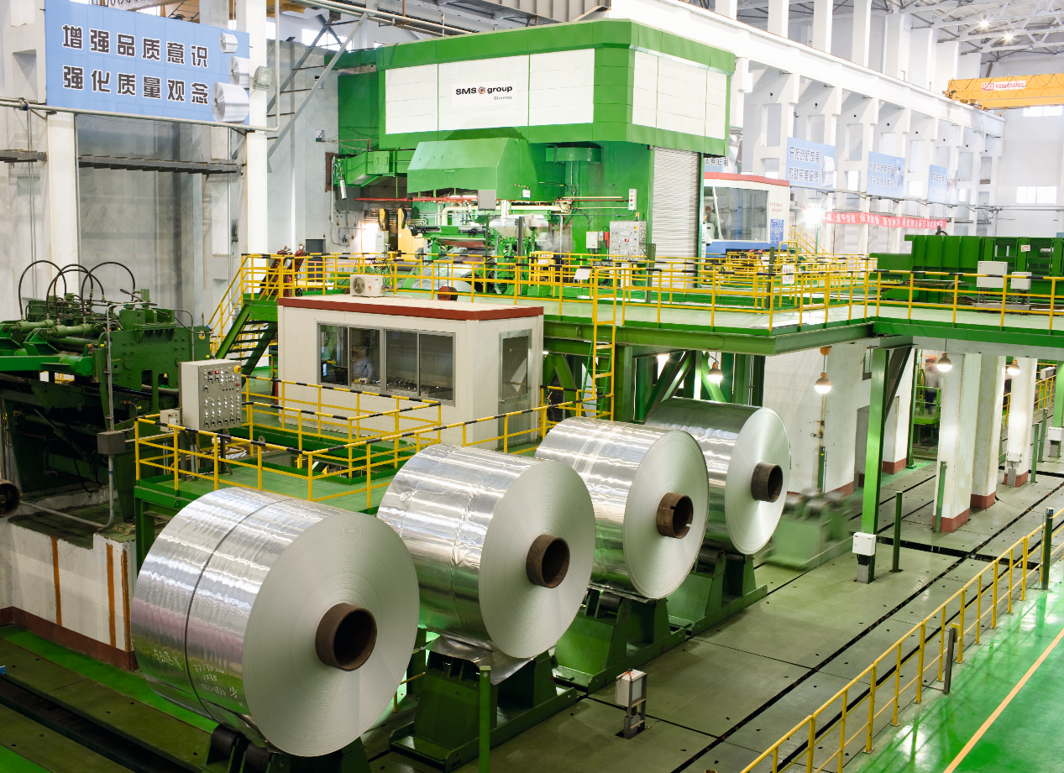
3. Mutual recognition of test protocols in the case of compliance with certain quality criteria (to be determined)
Some laboraties has not suffiecient equipment to test products.

Slide 6
4. Ensuring market access opportunities for German and Russian manufacturers and engineering companies by improving mutual recognition of testing services and thereby improving market access under certain quality conditions
Acceptance of technical EU documentation (Manual=technical Passport)
Posspibility of accreditation conform to TR CU of local expert personnel

Slide 7
Work Schedule |
Organisation Level
- meetings OAOV
and RSPP group (06.07.2018 following)
- international conferences
- public imaging
- exchange with RSPP
Management Level
- 02.10. 2018 Chemnitz (start)
- follow-up each second month (TELCO, meeting)
Membership Level
- membership recruitment
- expertise exchange
- position paper (12/2018 – 04/2019)
- general meeting (04/2019, Düsseldorf)
- finalising position paper (04/2019)

Slide 8
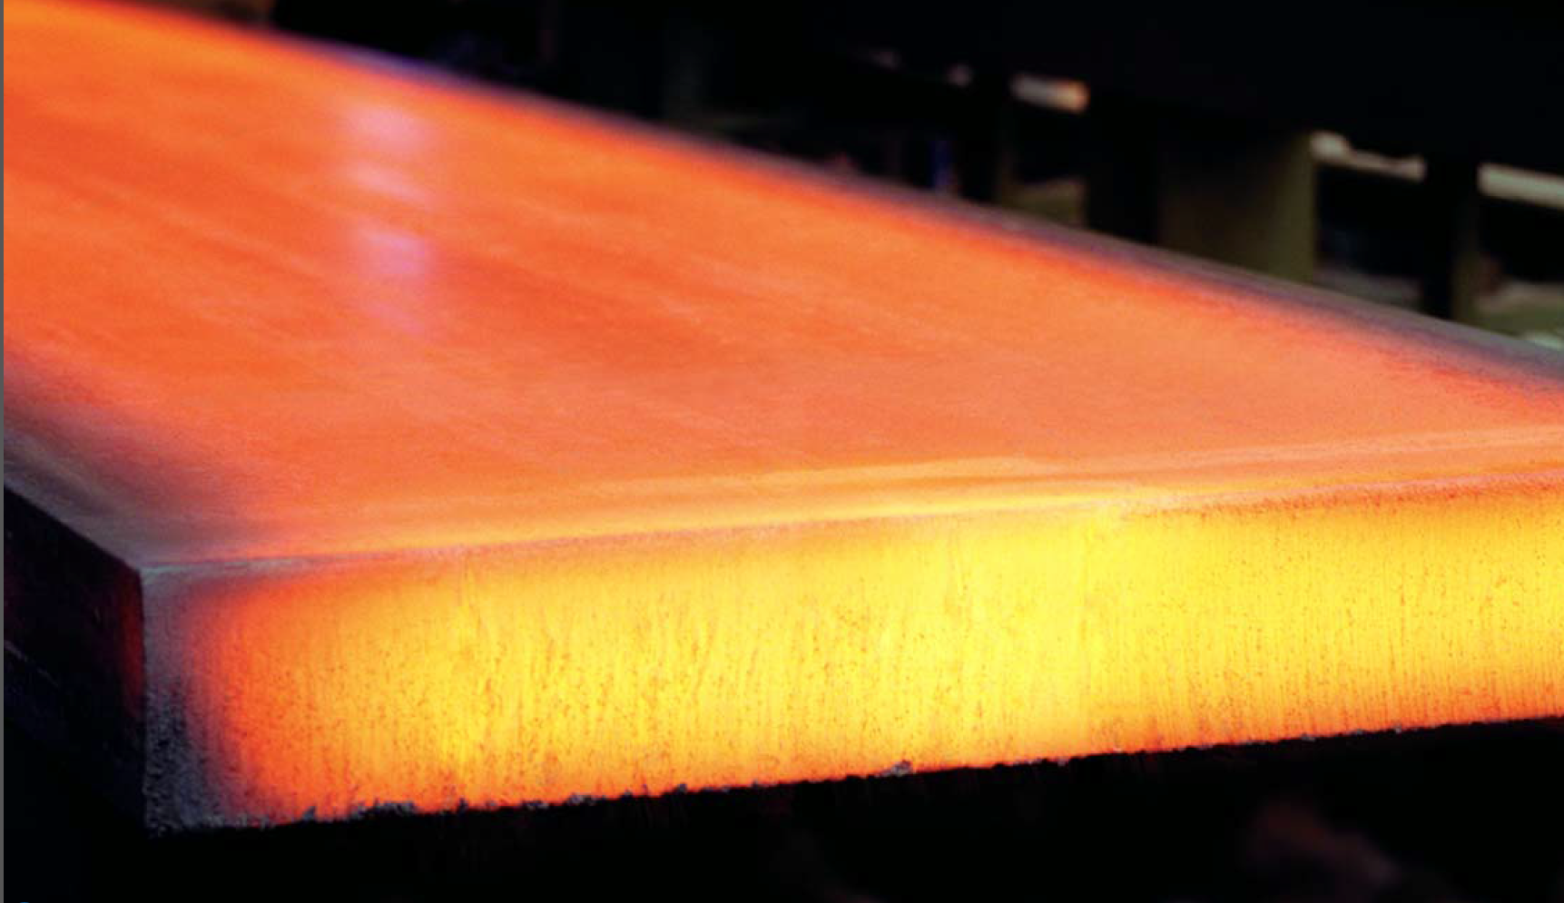
Position Paper|
Key interests of working group members:
Technical Regulation of the EAEU versus national requirements RF
Technical Compliance in the RF
Understanding of the licensing process of institutes / third parties
Mutual improvement market access for German and Russian manufacturer/engineering companies

Slide 9
Thank you very much for your attention!
Dr. Thomas Krause (thomas.krause@alpha-consulting.eu)

