Slide 1
ASTM Construction and Committee E06 Overview
www.astm.org

Slide 2
Committees Related to the Built Environment
A01 Steel
B05 Copper
C01/C09 Cement / Concrete
C11 Gypsum
C12/C15 Mortars and Grouts / Manufactured Masonry
C14 Glass
C16 Thermal Insulation
C24 Seals and Sealants
D01 Paints/Coatings
D07 Wood
D08 Roofing and Waterproofing
D14 Adhesives
D18 Soil and Rock
D20 Plastics
D22 Air Quality
E05 Fire Standards
E06 Performance of Buildings
E33 Acoustics
E50 Environmental Assessment/Risk Management
E60 Sustainability
F06 Resilient Floor Coverings
F16 Fasteners
F17 Plastic Pipe
G01 Corrosion of Metals
G03 Weathering and Durability

Slide 3
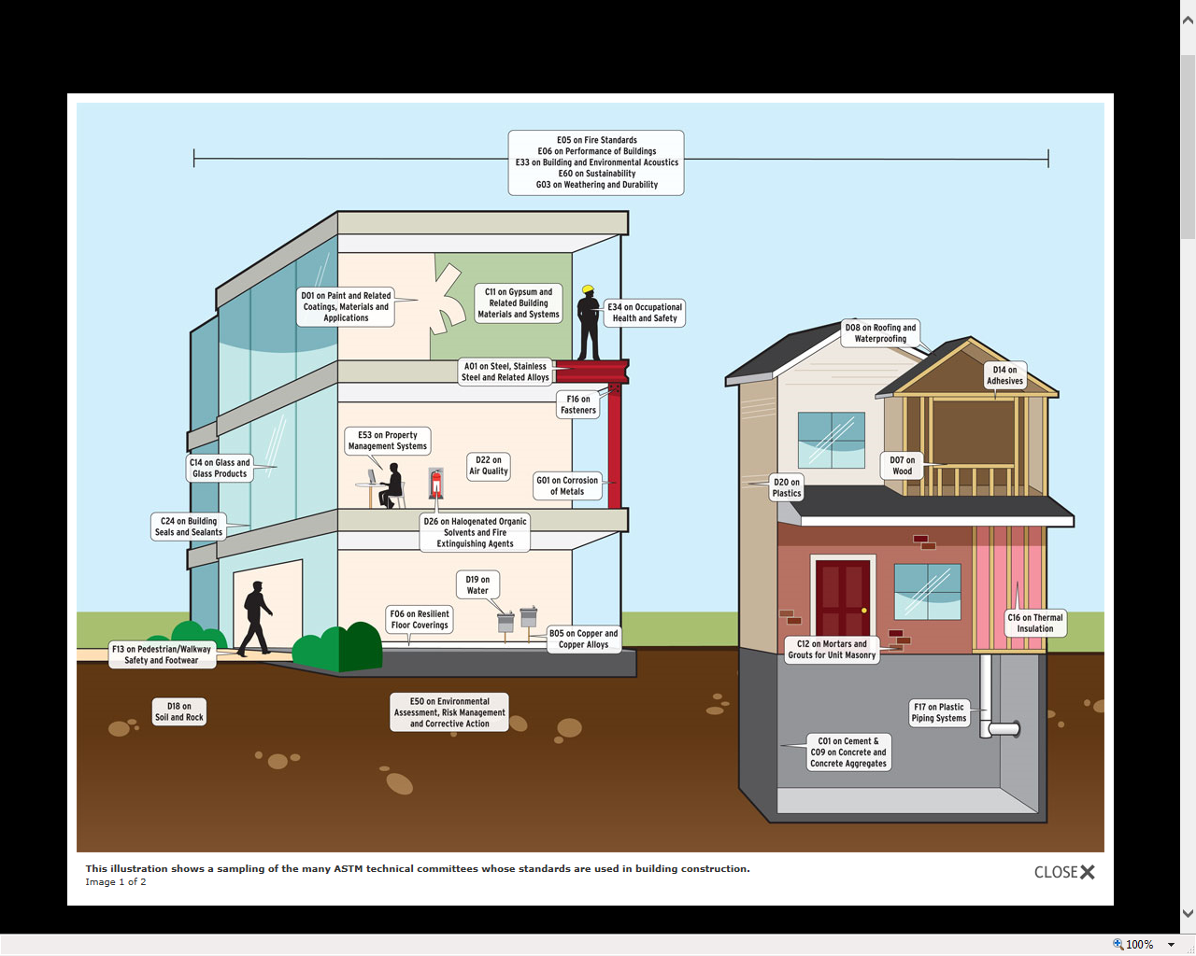
Committees Relating to the Built Environment

Slide 4
Technical Committee Structure:
E06 Performance of Buildings
Main Committee
Technical Committees Address specific industry subjects
Subcommittees
Address subsets of specialized subject matter
Subcommittee
E06.41
Subcommittee
E06.51
Subcommittee
E06.55
Task Groups
Organized by subcommittees: standards get drafted, revised, and developed at this level
Task Group
E06.51.02
Task Group
E06.51.11

Slide 5
Committee E06 on Performance of Buildings
Meetings Held Every Six Months
October Committee Week
April Committee Week
Established 1946
Over 1,300 Committee Members:
Manufactures, Trade Associations, Engineers, Architects, Testing Labs, Academia, Govt.
17 Technical Subcommittees
Approximately 250 Standards – Vol 04.11 and 04.12

Slide 6
List of E06 Subcommittees
E06.11 Horizontal and Vertical Structures/ Performance of Completed Structures
E06.13 Structural Performance of Connections in Building Construction
E06.21 Serviceability
E06.22 Durability Performance of Building Constructions
E06.24 Building Preservation and Rehabilitation Technology
E06.25 Whole Buildings and Facilities
E06.41 Air Leakage and Ventilation Performance
E06.51 Performance of Windows, Doors, Skylights and Curtain Walls
E06.52 Glass Use in Buildings
E06.53 Materials and Processes for Durable Rigidwall Relocatable Structures

Slide 7
List of E06 Subcommittees (Continued)
E06.54 Solid Fuel Burning Appliances
E06.55 Performance of Building Enclosures
E06.56 Performance of Railing Systems and Glass for Floors and Stairs
E06.57 Performance of Metal Roof Systems
E06.58 Exterior Insulation and Finish Systems (EIFS)
E06.77 High Rise Building External Evacuation Devices
E06.81 Building Economics
Administrative - Executive, Awards, Planning

Slide 8
E06 Subcommittee/Standards
E06.21 Serviceability (29)
E605/E605M Standard Test Methods for Thickness and Density of Sprayed Fire-Resistive Material (SFRM)
E1399/E1399M Standard Test Method for Cyclic Movement and Measuring the Minimum and Maximum Joint Widths of Architectural Joint Systems
E2174 Standard Practice for On-Site Inspection of Installed Firestop Systems
E06.22 Durability Performance of Building Constructions (11)
E2190 Standard Specification for Insulating Glass Unit Performance and Evaluation
E3120 Standard Specification for Evaluating Accelerated Aging Performance of Environmentally Controlled Dynamic Glazings

Slide 9
E06 Subcommittee/Standards
E06.25 Whole Buildings and Facilities (29)
E2026 Standard Guide for Seismic Risk Assessment of Buildings
E06.41 Air Leakage and Ventilation Performance (17)
E779 Standard Test Method for Determining Air Leakage Rate by Fan Pressurization
E2178 Standard Test Method for Air Permeance of Building Materials

Slide 10
E06 Subcommittee/Standards
E06.51 Windows, Doors, Skylights and Curtain Walls (24)
E283 Standard Test Method for Determining Rate of Air Leakage Through Exterior Windows, Curtain Walls, and Doors Under Specified Pressure Differences Across the Specimen
E331 Standard Test Method for Water Penetration of Exterior Windows, Skylights, Doors, and Curtain Walls by Uniform Static Air Pressure Difference
E1996 Standard Specification for Performance of Exterior Windows, Curtain Walls, Doors, and Impact Protective Systems Impacted by Windborne Debris in Hurricanes

Slide 11
E06 Subcommittee/Standards
E06.52 Glass Use in Buildings (6)
E1300 Standard Practice for Determining Load Resistance of Glass in Buildings
E06.55 Building Enclosure (13)
E2099 Standard Practice for the Specification and Evaluation of Pre-Construction Laboratory Mockups of Exterior Wall Systems
E2270 Standard Practice for Periodic Inspection of Building Facades for Unsafe Conditions
E2813 Standard Practice for Building Enclosure Commissioning

Slide 12
E06 Subcommittee/Standards
E06.58 Exterior Insulation and Finish Systems (EIFS) (12)
E2134/E2134M Standard Test Method for Evaluating the Tensile-Adhesion Performance of an Exterior Insulation and Finish System
E2568 Standard Specification for PB Exterior Insulation and Finish Systems

Slide 13
E06 Subcommittee/Standards
E06.81 Building Economics (29)
E917 Standard Practice for Measuring Life-Cycle Costs of Buildings and Building Systems
E1557 Classification for Building Elements and Related Sitework UNIFORMAT II
E1699 Standard Practice for Performing Value Engineering (VE)/Value Analysis (VA) of Projects, Products and Processes

Slide 14
Questions? www.astm.org Stephen Mawn smawn@astm.org Director TCO

